Slide 1

B.Tech Project External Evaluation , VIIIth Semester
Contrasting YOLO Models for the Formulation of Diaphanous and Robust Object Detection System
presented by: under the guidance of:
Abhishek Singh(2019576312) Dr. Anuj Kumar
Ronit Attrey(2019001770) Asst. professor
Sharda university
DEPARTMENT OF COMPUTER SCIENCE & ENGINEERING
SCHOOL OF ENGINEERING AND TECHNOLOGY
^{th} MAY ,2023
1

Slide 2
Approval from guide for the EXTERNAL EVALUATION

Slide 3
Contents of the Presentation:
INTRODUCTION
MOTIVATION
PROBLEM STATEMENT/OBJECTIVE
LITERATURE SURVEY
MEETING DETAILS
WORKLOAD DISTRIBUTION
SOFTWARE REQUIREMENT AND ALGORITHMS USED
ARCHITECTURE
ALGORITHM
RESULT
REFERENCE

Slide 4
INTRODUCTION
In the Domain of Artificial Intelligence, the Inclusion of any Modular Approach into a Real-time System is only possible if that Particular System is Light-Weight, Accurate, Less Complex and Reliable.
As per World Health Organization (WHO), Around 2.2 Billion People are Visually Impaired across the Globe.
Visually impaired persons (vips) face difficulties in performing activities of daily living (adls) e.g. opportunity of work and schooling, moving in their surroundings, ability to interact with the environment, and searching for common objects (indoor/outdoor) at their own or even with some assistance.
Moreover, as per the research carried out in university of California, around 20% blinds in the world, face an unintentional mobility accidents which causes unwanted deaths.
As a result, the creation of system for the blinds, to ease their commute stands to be the demand of time. with the initiation of the process of incorporating a system with hardware and software, the real challenge lies in gauging a software system which could be easily imbibed into a hardware and could be used by the visually impaired, in their day-to-day workflow.

Slide 5
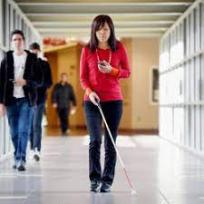
MOTIVATION
The motivation for this Object detection and distance estimation model can be used in the following criteria:
Blind people do lead a normal life with their own style of doing things but, they definitely face troubles due to inaccessible infrastructure and social challenges. the biggest challenge for a blind person, especially the one with the complete loss of vision, is to navigate around places.
obviously, blind people roam easily around their house without any help because they know the position of everything in the house. blind people have a tough time finding objects around them.
We Tried to Explicate a System which would Help the Blind People in Commuting on Roads by Some Extent.

Slide 6
PROBLEM STATEMENT
Blind individuals live regular lives, each with their unique way of doing things. they do, however, encounter difficulties as an effect of inaccessible infrastructure and societal constraints. the most difficult issue for a blind person, especially one who has lost full vision, is navigating about locations. obviously, blind people can go around their house without assistance since they know where everything is. blind persons have a problematic difficulty locating items around them.
Most common problems faced by visually impaired people-
navigating around places.
finding reading material.
arranging clothes.
overly helpful individuals.
getting devices to become independent.

Slide 7
LITERATURE SURVEY
Serial No. | Paper Title | Topic/Technology Discussed | Publisher
1. | CNN-Based Object Recognition and Tracking System to Assist Visually Impaired People | A robust and accurate object recognition tool is presented in this paper. Object Detection is done through using CNN-based low-power Mobile-Net architecture. It assists them in visualizing the environment and providing a sense of the surroundings. | IEEE Access (2022): 14819-14834.
2. | Wearable assistive devices for visually impaired | proposed a survey of wearable and portable assistive devices dedicated to blind and visually impaired users, while providing a deep and critical analysis of related strengths and limitations | Pattern Recognition Letters, 2020 - Elsevier
3. | IoT Enabled Automated Object Recognition for the Visually Impaired | This paper has proposed an IoT-enabled automated system that can help visually impaired in their safe navigation and identifies several common objects in indoor and outdoor environments in real-time scenarios. | Computer Methods and Programs in Biomedicine, update,1,10005, 2021 - Elsevier

Slide 8
Serial No. | Paper Title | Topic/Technology Discussed | Publisher
4. | Object Detection using Machine Learning Technique | Detecting real time objects in image, video and camera. Bounding Boxes were drawn around the detected objects along with the label indicating the class to which the object belongs. YOLO algorithm along with CNN for better and faster detection of objects. | International Research Journal of Engineering and Technology (IRJET)
5. | Design and Implementation of an Intelligent Assistive System for Visually Impaired People for Aerial Obstacle Avoidance and Fall Detection. | An intelligent assistive system has been proposed for visually impaired people for aerial obstacle avoidance and fall detection. The proposed intelligent assistive system comprises wearable smart glasses, an intelligent walking stick, a cloud-based information platform, and a mobile device app | IEEE SENSORS JOURNAL: Sensors-31523-2020.R1

Slide 9
Serial No. | Paper Title | Topic/Technology Discussed | Publisher
6. | "Object recognition with machine learning for people with visual impairment." | developed an android application that implements CNN to classify objects and transfer it to text to speech module. | 15th International Conference on Advanced Technologies, Systems and Services in Telecommunications (TELSIKS). IEEE, 2021
7. | "LightNet : A Lightweight 3D Convolutional Neural Network for Real-Time 3D Object Recognition." | lightweight 3-D Convolutional Neural Network for real time three dimensional object recognition through limited amount of training parameters. | 3DOR@ Eurographics. 2017.
8. | "Google glass used as assistive technology its utilization for blind and visually impaired people." | presented a method that supports blind people through a system powered by Android, other impaired persons. It provides navigation in addition to aiding with obstacle detection. | International Conference on Mobile Web and Information Systems. Springer, Cham, 2017.
9. | "Design and implementation of an intelligent assistive system for visually impaired people for aerial obstacle avoidance and fall detection." | developed a smart difficulty finding system for visually impaired persons. The system consists of a walking stick, smart glasses, a platform that relies on the cloud, and a mobile app. Blind person uses walking stick and smart glasses to identify obstacles. Vibrations are set off by the designed stick to guide VIPs. | IEEE Sensors Journal 20.17 (2020): 10199-10210.

Slide 10
Serial No. | Paper Title | Topic/Technology Discussed | Publisher
10. | "Obstacle detection using GoogleNet." | unveiled a deep neural network-based camera system for detecting impediments (DNN). The method uses supervised deep neural networks to extract local properties from the image while using unsupervised deep neural networks to obtain the image's global attributes. | 2018 8th International Conference on Computer and Knowledge Engineering (ICCKE). IEEE, 2018.
11. | "MobileAid: A Fast and Effective Cognitive Aid System on Mobile Devices." | a mobile device-based assistance programme that helps visually impaired individuals recognise objects. This system's fundamental concept presented a lightweight, neural network design for target recognition that combines object and context recognition with little time delay. They created a light-wieght CNN by combining pooling layers and activation function selection, which provides higher accuracy | IEEE Access 8 (2020): 101923-101933
12 | "Object detection using machine learning technique." | a system that detects objects from the image or a video given to the system in real time or in the form of records. Bounding containers will be drawn around the objects that are being identified by the system. The system will also categorize the object to the class to which it belongs ‘YOLO’ (You Only Look Once) algorithm using Convolutional Neural Network is used for the Object Detection. | Int. Res. J. Eng. Technol. (IRJET) (2019): 7948-7951

Slide 11
WORKLOAD DISTRIBUTION
Abhishek Singh
Understanding the problem Domain
Information Gathering
Literature Survey
Organized Dataset
Understanding different approaches for the problem
Implementation
Paper writing
RONIT ATTREY
Understanding the problem Domain
Paper Collection
Analyzing algorithms and approaches
Literature Survey
Coding
Presentation
Paper writing
Documentation

Slide 12
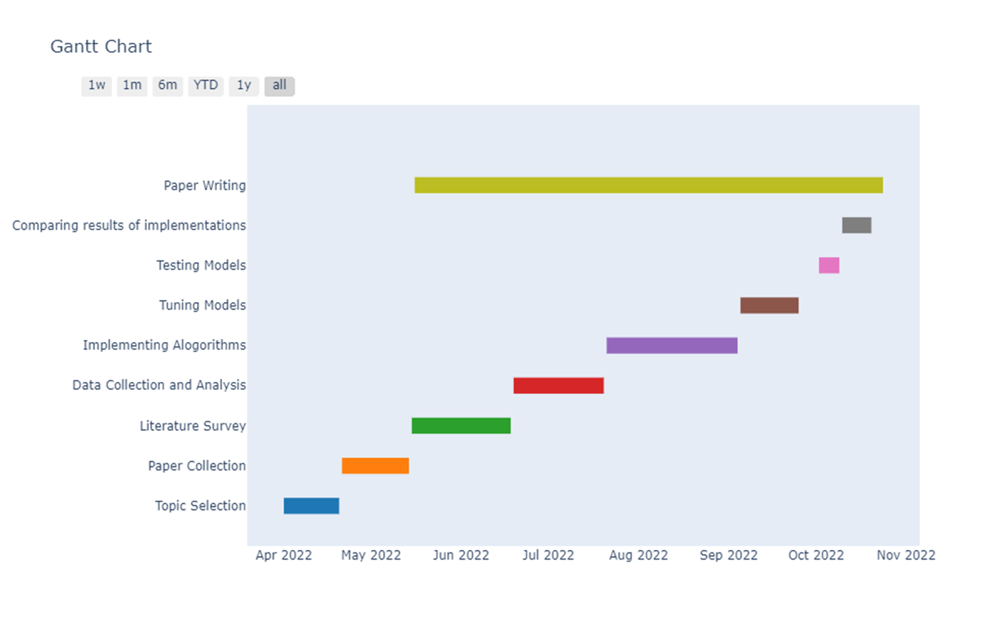
PROJECT PLANNING AND WORK SCHEDULE (GANTT-CHART)

Slide 13
METHODOLOGY USED
The Methodological Outlook was Created with Deep Implorations, Taking into Consideration the Basics of Object Detection which is Demonstrated Visually in Figure.01.
We Selected State-of-the-Art YOLOv5 Model which has Proven its Efficacy in Varied Object Detection Utilities and YOLOv8 Model, which is the Latest and the More Complex Model of the You Only Look Once (YOLO) Family.
We’ve Endeavoured the State-of-the-Art YOLO Models i.e., YOLOv5 and YOLOv8 to Scrutinize the Impact of the Complexity of these Models on a Particular Dataset. With this Inclusion, we’ll be able to assuage a System which would be Diaphanous and Authentic for our Real-time Use Case.
Fig.1. Fundamental Flow of an Object Detection System.

Slide 14
METHODOLOGY USED
.
The Data Acquisition and Preparation: The Dataset which we Have Utilised in our Modus Operandi is Custom Made. We took Various Road Signs and Signals Instances from the Internet and Amalgamated them to form a Strength of 2093 Images with 17 Classes. The Median Image Ratio is 640x640 as we’re Dealing with YOLO Models and Average Image Size is 0.41 Mega Pixel (MP).
The Training of Object Detection Modular Networks: After the Initial Step of Data Acquisition and Data Preparation, now it’s Time to Train the Selected Models over the Same. As we Selected YOLOv5 and YOLOv8 Models from the YOLO Family for Training, Let’s Understand the Modular Aspect of Each of These Models and also the Contrasting Factor Between Them.

Slide 15
ARCHITECTURE OF PROPOSED SYSTEM
C. mean absolute precision (map): the map is one of the most famous metric utilized for gauging the accuracy of an object detection model which is calculated with the inclusion of following sub-metrics i.e., confusion matrix, intersection over union (iou), recall and precision. the value of map lies between 0 to 1. the formula for map is demonstrated below, where ‘ap’ is the average precision which is calculated for each class initially and then it’s averaged over the overall number of classes in a dataset.
𝑚𝐴𝑃=1𝑁Σ𝐴𝑃𝑖

Slide 16
RESULT
After the implementation we effectuated, the results which we got were highly insightful and we got the desired analysis, which we were expecting.
YOLOv5 Analysis:
On Training YOLOv5 Model over our Road Sign and Signal Dataset, the mAP which we Obtained were, a] mAP50: 96% and, b] mAP50-95: 80%. The Mean Absolute Precision (mAP) which we got is Really Promising, when Compared to Other Existing Modular Prospects. Figure.0, Depicts the Graphical Illustration for YOLOv5 Performance.

Slide 17
RESULT
YOLOv8 Analysis:
on training yolov8 model over our road sign and signal dataset, the map which we obtained were, a] map50: 94.5% and, b] map50-95: 79.5%. the mean absolute precision (map) which we got is really promising, when compared to other existing modular prospects. figure.08, depicts the graphical illustration for yolov5 performance.

Slide 18
CONCLUSION
Thus, our experimental analysis was successful and gave us a clear insight of the model which we would be using as a software.
As our End Goal is to Create a Real-time System to aid the Visually Impaired, we needed a Model which would be Light-Weight, Fast and Reliable.
After analysing, the Overall and Class-Wise Results of Both the YOLO Models, YOLOv5 Performed Better with Our Dataset Even being Less Complex, when Compared to YOLOv8.
The Performance of Both the Models are Top-Notch, but for our Modus Operandi, YOLOv5 Suits the Best and also Gave us the Insight that the Complexity of the Models isn’t Directly Proportional to the Accuracy.
The Whole Flow, Depends Upon the Dataset and the Tuning which is Arbitrarily Done. Furthermore, With the Integration of YOLOv5 along with the Text to Speech Amalgamation, a Wearable Can be Introduced for the Visually Impaired to Be Safe on Roads and thereby Ease their Commute as Well. There’s always a Scope of Improvement and More Dataset and More Tuning are some of the Most Probable Areas where you can Increase the Model’s Efficacy Even More.

Slide 19
REFERENCES
Chang, Wan-Jung, et al. "Design and implementation of an intelligent assistive system for visually impaired people for aerial obstacle avoidance and fall detection." IEEE Sensors Journal 20.17 (2020): 10199-10210.
Rahman, Md Atikur, and Muhammad Sheikh Sadi. "IoT enabled automated object recognition for the visually impaired." Computer Methods and Programs in Biomedicine Update 1 (2021): 100015.
Ashiq, Fahad, et al. "CNN-based object recognition and tracking system to assist visually impaired people." IEEE Access 10 (2022): 14819-14834.
Tapu, Ruxandra, Bogdan Mocanu, and Titus Zaharia. "Wearable assistive devices for visually impaired: A state of the art survey." Pattern Recognition Letters 137 (2020): 37-52.
Denić, Damjan, Predrag Aleksov, and Igor Vučković. "Object recognition with machine learning for people with visual impairment." 2021 15th International Conference on Advanced Technologies, Systems and Services in Telecommunications (TELSIKS). IEEE, 2021
Zhi, Shuaifeng, et al. "LightNet: A Lightweight 3D Convolutional Neural Network for Real-Time 3D Object Recognition." 3DOR@ Eurographics. 2017.
Berger, Ales, et al. "Google glass used as assistive technology its utilization for blind and visually impaired people." International Conference on Mobile Web and Information Systems. Springer, Cham, 2017.
Chang, Wan-Jung, et al. "Design and implementation of an intelligent assistive system for visually impaired people for aerial obstacle avoidance and fall detection." IEEE Sensors Journal 20.17 (2020): 10199-10210.
Salavati, Pouyan, and Hossein Mahvash Mohammadi. "Obstacle detection using GoogleNet." 2018 8th International Conference on Computer and Knowledge Engineering (ICCKE). IEEE, 2018.
Liu, Xinyi, et al. "MobileAid: A Fast and Effective Cognitive Aid System on Mobile Devices." IEEE Access 8 (2020): 101923-101933.
Amin, Praahas, et al. "Object detection using machine learning technique." Int. Res. J. Eng. Technol. (IRJET) (2019): 7948-7951

